Slide 1
ArabicSeek
An End-to-End Semantic Retrieval and Hybrid Summarization
Platform for Arabic News Archives
Mohammed Almadhoun · Layan Khaddash · Shatha Al-Ghrair
Faculty of Information Technology, Middle East University
Amman, Jordan

Slide 2
MOTIVATION
The Problem: Searching Arabic News
▸ Arabic news archives grow by thousands of articles per day (Al Jazeera, BBC Arabic, Al Arabiya).
▸ Keyword search (BM25) systematically fails on Arabic for three reasons:
– Rich morphology — one root yields dozens of surface forms, so a query term may never appear verbatim.
– Dialectal & orthographic variation — the same concept is spelled differently across editions.
– Vocabulary mismatch — natural-language queries share few tokens with relevant documents.
▸ Outcome: poor recall, missed synonyms, and eroded trust over long archives.
THE GAP
Retrieve by
meaning,
not by surface
words.
Production-ready Arabic
news systems remain
scarce in the literature.
ArabicSeek — Mohammed Almadhoun · Layan Khaddash · Shatha Al-Ghrair
02 / 12

Slide 3
APPROACH
Dense Semantic Retrieval
▸ Bi-encoder paradigm (DPR, Sentence-BERT): map queries and documents into a shared vector space where geometric proximity approximates meaning.
▸ Multilingual E5 (intfloat/multilingual-e5-large): zero-shot across 100+ languages including Arabic — no Arabic-specific fine-tuning.
▸ Engineering-grade and CPU-deployable: the full path runs end-to-end on commodity hardware.
▸ One integrated platform: scrape → clean → embed → cluster → search → summarize → interface.
Scrape
Clean + LLM fix
Preprocess
E5 Embed
UMAP + HDBSCAN
Cosine Search
Summarize
Streamlit UI
ArabicSeek — Mohammed Almadhoun · Layan Khaddash · Shatha Al-Ghrair
03 / 12

Slide 4
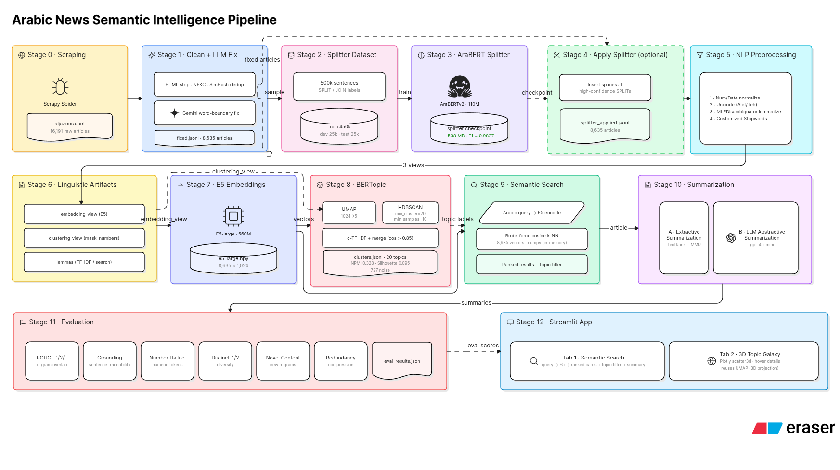
SYSTEM
Architecture — 12-Stage Pipeline
▸ Four functional layers: acquisition/cleaning/preprocessing · embedding · clustering & search · summarization, evaluation & interface.
▸ Stages communicate via versioned flat files (JSONL / NPY / CSV) — every stage is independently re-runnable.
ArabicSeek — Mohammed Almadhoun · Layan Khaddash · Shatha Al-Ghrair
04 / 12

Slide 5
PIPELINE · STAGES 0–2
Data & Ambiguity-Aware Preprocessing
▸ 16,191 articles scraped from aljazeera.net → 8,635 unique after SimHash de-duplication.
▸ Gemini-powered word-boundary fixer repairs glued / split Arabic tokens at scale.
▸ Three specialized views per article:
– embedding_view — keeps digits & Latin for semantic embedding.
– clustering_view — numbers → typed tokens so TF-IDF focuses on themes.
– lemmas — CAMeL MLE lemmatizer + customized Arabic stopwords.
CORPUS MIX
News (Akhbar)
40.3%
Unspecified
31.2%
Sports
13.8%
Economy
8.2%
Technology
2.5%
Other
3.9%
News subset = deployed search & topic index.
ArabicSeek — Mohammed Almadhoun · Layan Khaddash · Shatha Al-Ghrair
05 / 12

Slide 6
PIPELINE · STAGES 7–8
Embeddings & Topic Discovery
▸ E5-large encodes each article into a 1,024-d L2-normalized vector — array shape 8,635 × 1,024.
▸ Topic model on the 3,480-article News subset: UMAP (1024→5, cosine) + HDBSCAN (min_cluster=15, min_samples=10).
▸ HDBSCAN needs no preset cluster count, flags a noise class, and gives soft membership confidences.
▸ Labels via class-based TF-IDF (top-3 terms per cluster).
20
727
coherent topics
noise (20.9%)
0.328
0.095
topic NPMI
silhouette
ArabicSeek — Mohammed Almadhoun · Layan Khaddash · Shatha Al-Ghrair
06 / 12

Slide 7
PIPELINE · STAGE 9
CPU-Deployable Semantic Search
▸ Query → 'query:' prefix → E5 encode → cosine over 3,480 normalized vectors in a single NumPy dot product.
▸ Each hit enriched with its topic label + membership probability; optional topic filter for browsing.
▸ Exact cosine beats FAISS below ~100k docs — no quantization overhead; FAISS backend ready for scale.
0.19 s
mean query latency (CPU, no GPU)
34 MB
embedding matrix
2.1 GB
E5 model weights
< 1 s
Miller interactive threshold
ArabicSeek — Mohammed Almadhoun · Layan Khaddash · Shatha Al-Ghrair
07 / 12

Slide 8
PIPELINE · STAGE 10
Faithfulness-First Hybrid Summarization
Small Arabic abstractive models hallucinate on long news — so the default never fabricates content.
TIER 1 · DEFAULT
TIER 2 · ON-DEMAND
TIER 3
Faithful Extractive
LLM Refinement
Key-Point Bullets
TextRank (PageRank) over an E5 sentence graph + MMR (λ=0.7). Selects original sentences — faithful by construction.
gpt-4o-mini repairs residual word-boundary errors and writes a fluent, faithful summary. Opt-in (API key), cached.
Pattern-based scorer over seven Arabic families (speech, events, quantities…) surfaces up to four bullet highlights.
ArabicSeek — Mohammed Almadhoun · Layan Khaddash · Shatha Al-Ghrair
08 / 12

Slide 9
PIPELINE · STAGE 12
Editorial-Grade Bilingual Interface
▸ Streamlit front-end with a dark editorial theme (#0f172a / gold #c8a96e) and full RTL Arabic (Cairo / Tajawal).
▸ Tab 1 — Semantic Search: ranked cards (score, topic, category, date, snippet) + one-click summary.
▸ Tab 2 — 3D Topic Galaxy: Plotly scatter3d of the UMAP projection, colored by cluster, title on hover.
▸ Real-time breaking-news ticker and a live stats panel (corpus size, #topics, mean latency).
⌕ ArabicSeek — بحث دلالي
#1 News headline …
cos 92% · topic · 2026-05
#2 News headline …
cos 88% · topic · 2026-05
#3 News headline …
cos 84% · topic · 2026-05
ArabicSeek — Mohammed Almadhoun · Layan Khaddash · Shatha Al-Ghrair
09 / 12

Slide 10
EVALUATION
Retrieval Performance
▸ 30 Arabic queries, 5 domains; top-5 binary relevance by 2 annotators (3rd adjudicates ties).
▸ Mean NDCG@5 = 0.79 vs BM25 0.61 (+0.18) — paired Wilcoxon signed-rank test, p < 0.01.
▸ Biggest gains on paraphrastic tech & health queries; sports flat (lexically invariant names).
Query (topic) | Dense | BM25 | Δ
Artificial intelligence (tech) | 0.91 | 0.55 | +0.36
Infectious diseases (health) | 0.74 | 0.48 | +0.26
United Nations (politics) | 0.85 | 0.72 | +0.13
Gaza war (politics) | 0.88 | 0.81 | +0.07
Mean (all 30) | 0.79 | 0.61 | +0.18
+18
NDCG@5 points over BM25
statistically significant (p < 0.01)
ArabicSeek — Mohammed Almadhoun · Layan Khaddash · Shatha Al-Ghrair
10 / 12

Slide 11
EVALUATION
Summarization Quality
▸ Compared seven strategies → faithful extractive chosen (mT5 / AraT5 hallucinated on long articles).
▸ Intrinsic metrics on 60 articles: deployed TextRank+MMR vs a simpler extractive baseline.
Metric | Baseline | Deployed
Number hallucination ↓ | 0.203 | 0.067
Redundancy ↓ | 0.082 | 0.068
Grounding ↑ | 0.552 | 0.560
Distinct-2 ↑ | 0.918 | 0.932
Length (words) | 75.2 | 58.9
KEY RESULT
Hallucinated numbers cut
0.20 → 0.07
…while summaries got more concise (75 → 59 words) and more grounded.
ArabicSeek — Mohammed Almadhoun · Layan Khaddash · Shatha Al-Ghrair
11 / 12

Slide 12
WRAP-UP
Conclusion & Future Work
ArabicSeek delivers end-to-end Arabic semantic search + faithful summarization on commodity hardware — NDCG@5 0.79 (+18 pts over BM25), sub-second latency, 20 discovered topics.
FUTURE WORK
▸ Arabic bi-encoder fine-tuning on domain relevance pairs.
▸ Cross-lingual retrieval (English → Arabic via LaBSE).
▸ Neural topic labeling (seq2seq Arabic labels).
▸ Multi-document cluster digests.
▸ FAISS backend for million-scale indexes.
Thank you
Mohammed Almadhoun
Layan Khaddash
Shatha Al-Ghrair
Middle East University · Amman, Jordan
ArabicSeek — Mohammed Almadhoun · Layan Khaddash · Shatha Al-Ghrair
12 / 12

